Slide 1

By
Kumar Debjit
1006029
IT(1)

Slide 2
Introduction
A School Management System is an online webpage which can be used for managing school tasks or related tasks.
It is configurable and can be configured to meet most individual school's needs.
It is a multi-user system and can be used by hundreds of users at same time.
There will be three sections for teachers, parents and students

Slide 3
requirements
Platform : PHP
Database : MySQL
Browser : Google Chrome/Mozilla
System : Windows XP or Later

Slide 4
objectives
Students Information
Teacher Information
Parent Access
Attendance
Grade Book
Report Card

Slide 5
Mailing
Scheduling

Slide 6
Analysis & Design
The requirements specification document was created.
Existing documents were a good reference.

Slide 7
facilities
Teacher :
Update Home work
Update schedule
Monitoring Student
To Emphasize on weak students would be more easier

Slide 8
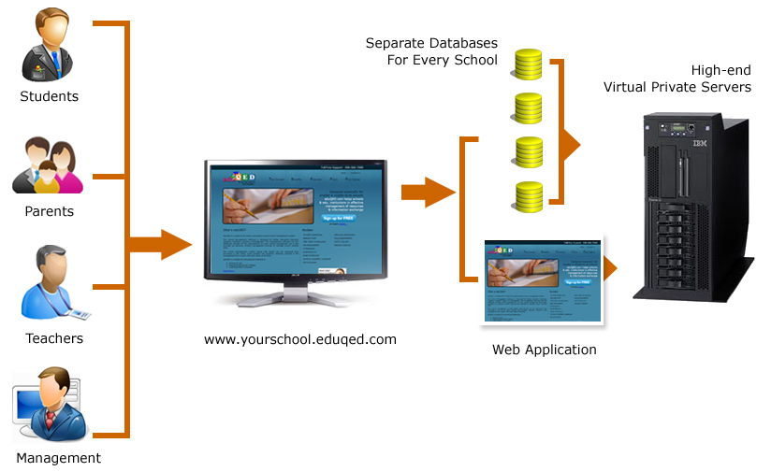

Slide 9
Entity Relationship Diagram
M
ADD
EMPLOYEE
1
Gets
M
PAYMENT
EMP_ATTENDENCE
Has
1
Has
1
1
Daily_Time
_Table
WORKING_DAYS
Has
Has
M
M
STU_ATTENDENCE
M
Has
M
DESIGNATION
1
Has
ALLOWNCES
FEES
M
Has
1
M
1
1
M
Has
M
TEARCHERS
ADD STUDENT
1
1
CATEGORY_FEES
1
M
1
Pays
SOFTWARE_SETTING
1
Teach
Has
Has
Has
M
M
1
CLASS
1
Has
M
DIVISION
1
Has
M
SUBJECTS
M
1
QUALIFICATION
RELIGION
1
Has
M
CASTE
M
Has
1
CATEGORY
Appear
M
EXAM
M
Has
M
EXAM_TIME_TABLE
1
Has
Gets
1
M
Has
M
EXAM_DATES
M
Has
SUBJECT_TIME_TABLE
M
MARKS
M
VENDORS
Provides
PRODUCTS
1
M

Slide 10
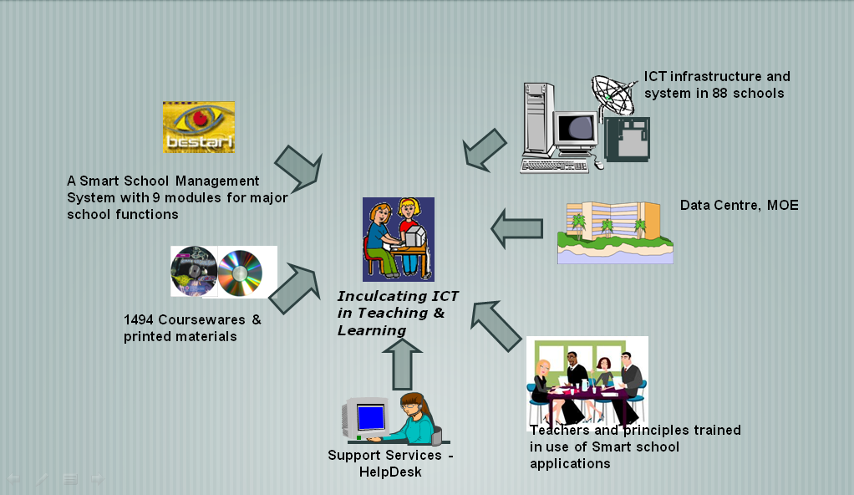

Slide 11
Student :
Check on the schedules
Update about attendance
Update about events
See grade points from home
Get informed about home works

Slide 12
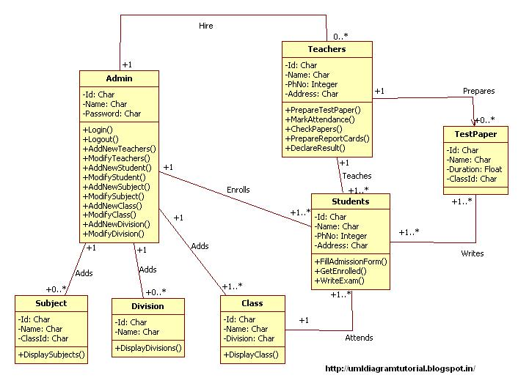
class diagram

Slide 13
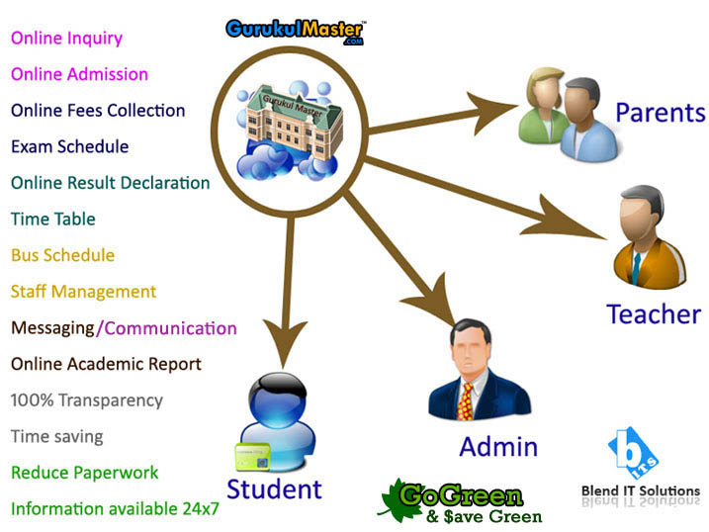

Slide 14
Parents :
Monitor on their children
Take necessary action to improve
Know about teachers
Aware of upcoming events
Save time of consulting

Slide 15
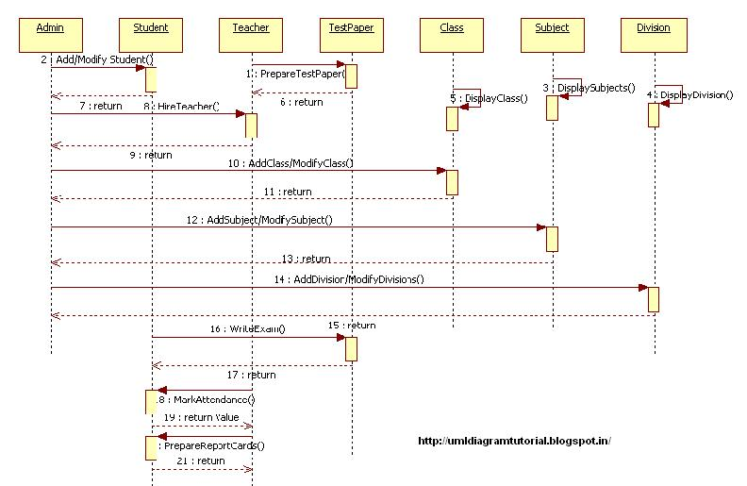
Sequence diagram

Slide 16

HOME PAGE

Slide 17
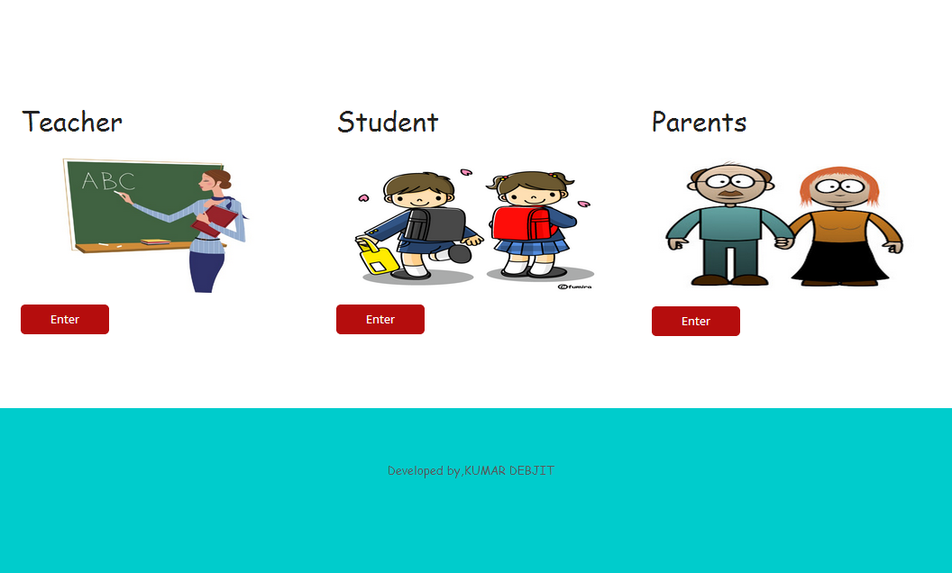

Slide 18
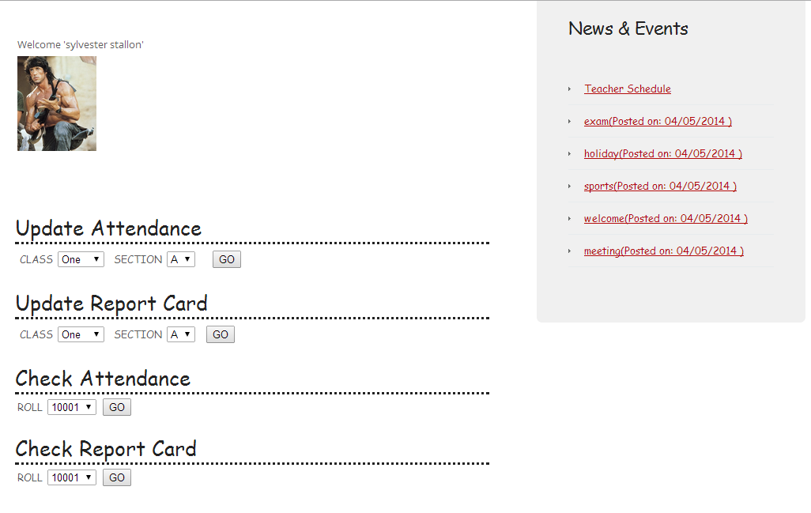
Teacher Section

Slide 19
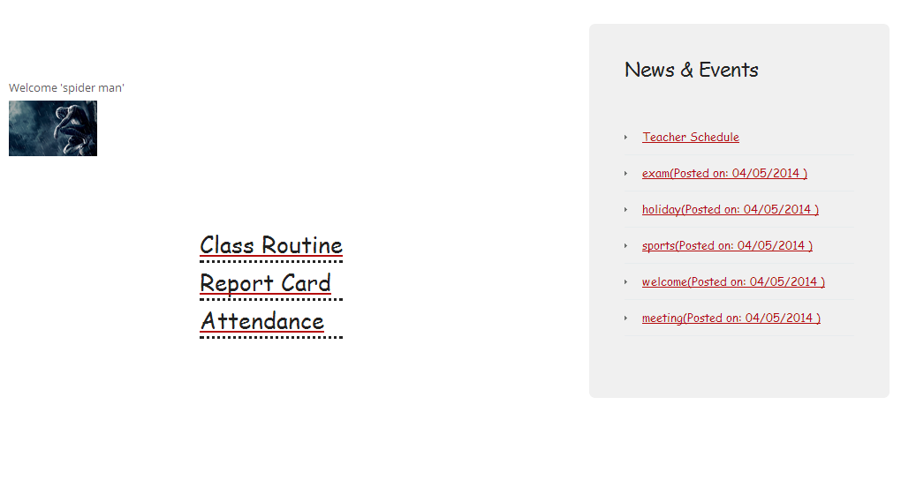
Student section

Slide 20
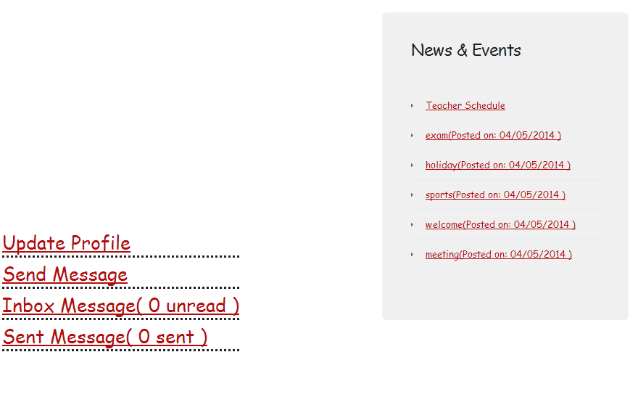
Mail home page

Slide 21
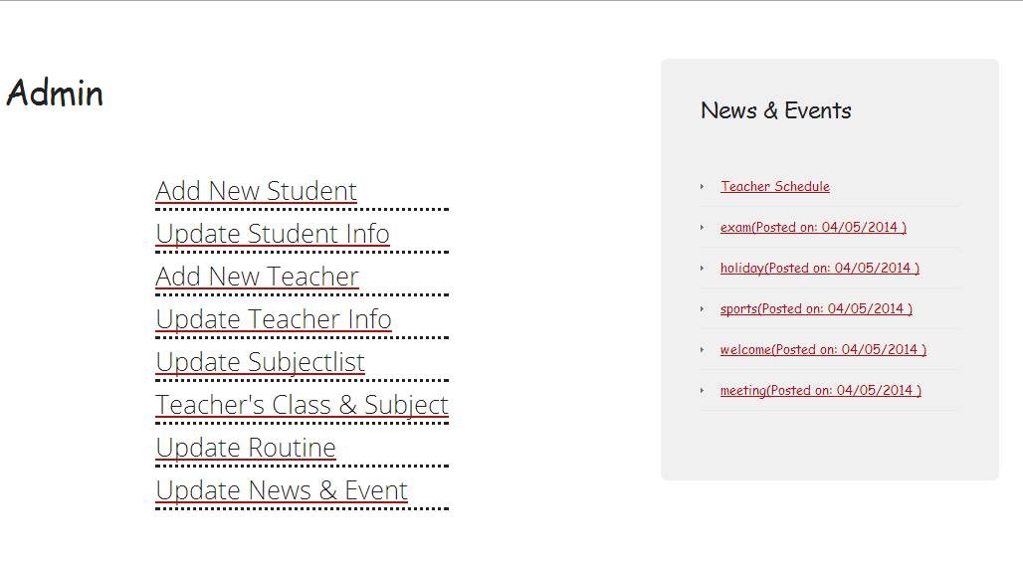
Admin page

Slide 22


Slide 23
Thank You…..

